Slide 1

Convolution Neural Network
Crack Detection

Slide 2
Artificial Neural Network (ANN)
Inspired by the operational process of biological nervous systems.
Consists of high number of interconnected computational nodes.
The purpose is to learn collectively from inputs for optimizing its final output.
Input layer takes multi-dimensional data, passes it to hidden layer.
Hidden data makes decision based on weighed connection.
Goal-improving prediction accuracy of the network by iteratively adjusting the weights based on observed error.

Slide 3
Convolution Neural Network
Form of ANN commonly preferred for image and video processing.
Uses convolution layers extracts local features from the input data followed by pooling layers that down sample the features to reduce their dimensionality.
Down sampling extracts most important details while discards less important details.
Hierarchical feature extraction of CNN allows model to capture complex patterns and spatial relationships in the input data.

Slide 4
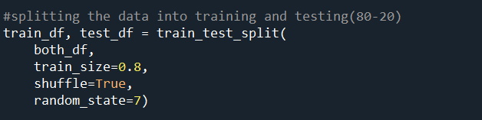
Details about data
The number of images for crack- 450
The number of images for non-crack-350
80% train data and 20% test data

Slide 5
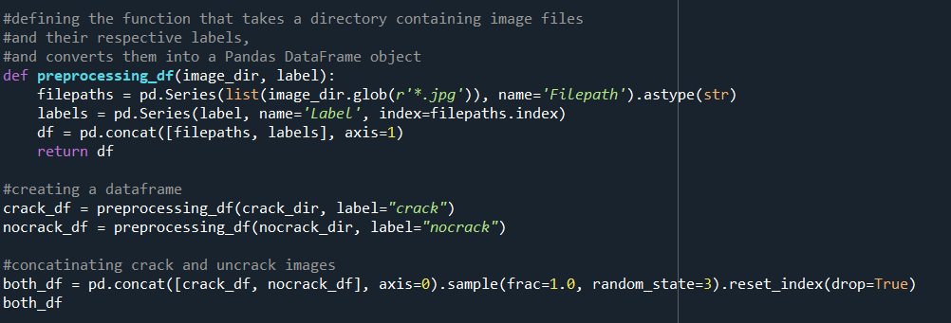
Preprocessing of images

Slide 6
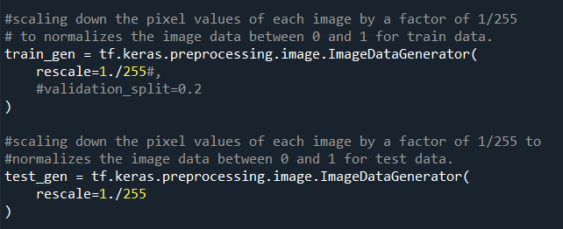
Rescaling of images

Slide 7
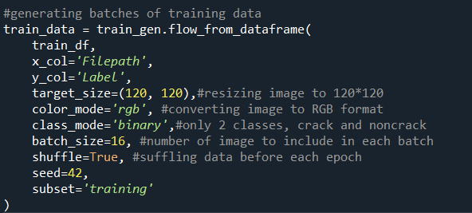

Slide 8
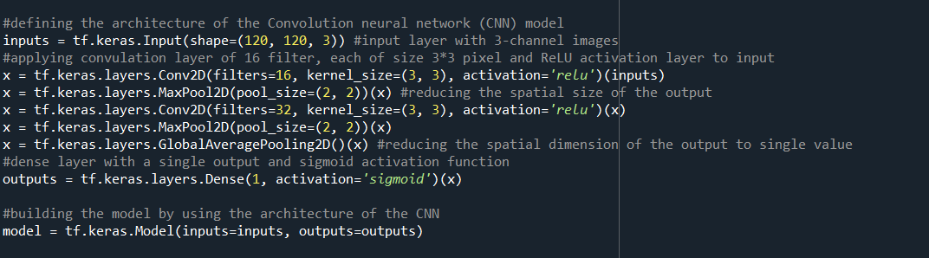
Building model

Slide 9
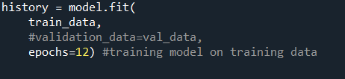
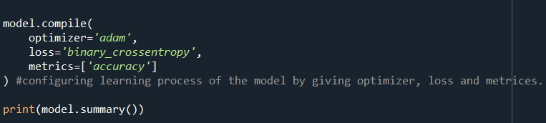
Model compilation & fit

Slide 10
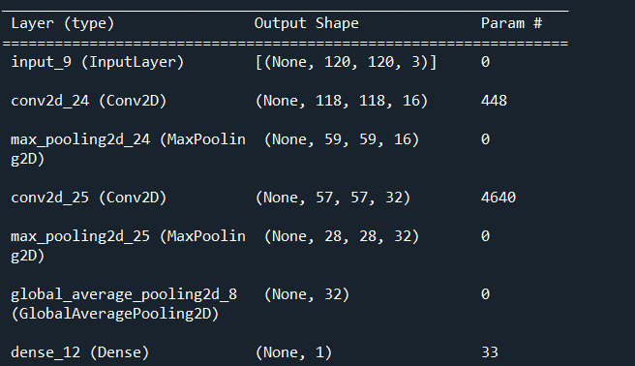
Model Architecture

Slide 11
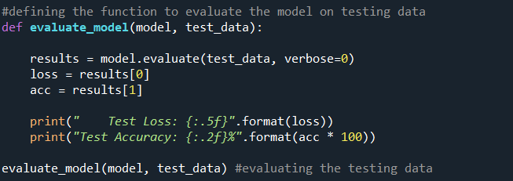
Evaluating the model

Slide 12


Results for training & testing data for own datasets

Slide 13
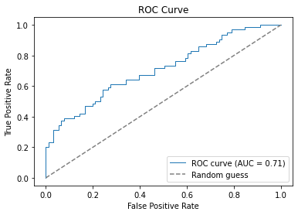
ROC curve for own datasets
Evaluates the overall performance of a binary classification model.
Ranges from 0-1
0.5-random classifier and 1-perfect classifier

Slide 14

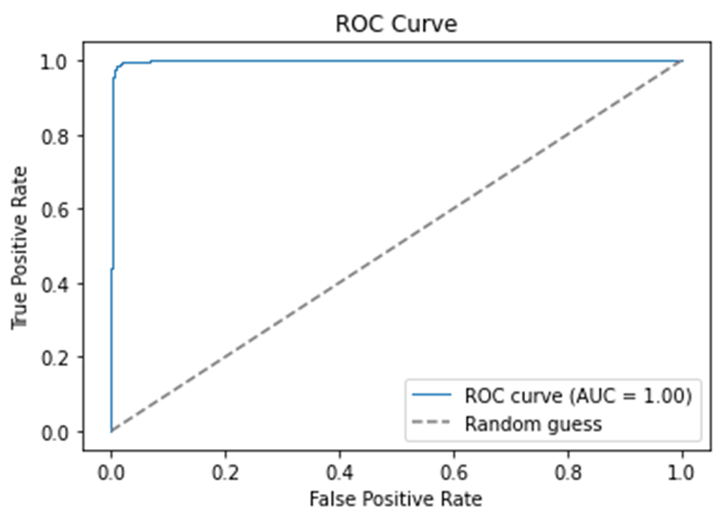

Results for Train and Test for Kaggle datasets

Slide 15
References
https://doi.org/10.48550/arXiv.1511.08458 https://www.kaggle.com/code/gcdatkin/concrete-crack-image-detection/notebook

